Slide 1

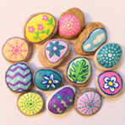
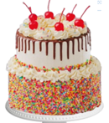

FANCY A
CUPPA?
Brews & News – Coffee, cake and chat
Wellbeing activities – Pebble Art
Get to know the new Family Engagement Officer
Explore opportunities for you as parents, carers, grandparents
Share your views about what you would like to do with your children and for your wellbeing and self growth
Tuesday 16th September
9.15 – 10.30am
Glyncorrwg Primary School
Lucy Labunsky-Grayson
Family Engagement Officer
07974 063887

