Slide 1
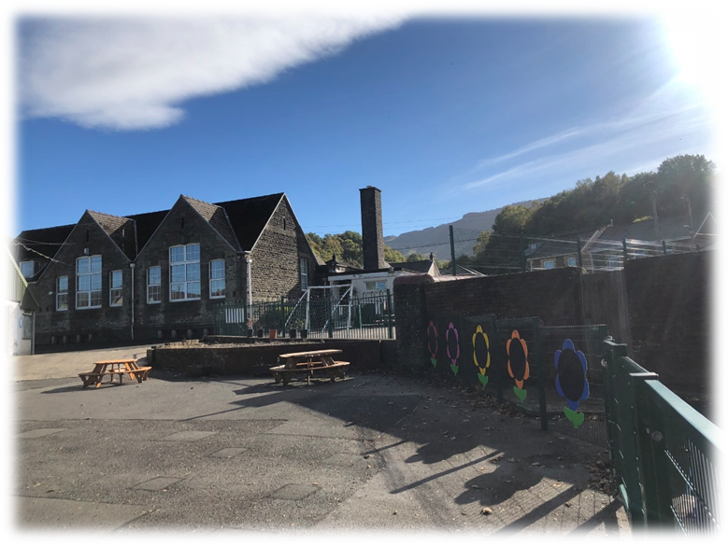
Blaengwrach Primary School
Governing Body Annual Report to Parents
2024-25

Slide 2


As we begin a brand-new year here at Blaengwrach Primary it is a pleasure to take the opportunity to reflect on last year’s successes and celebrate our development and progress, and the academic year 2024–2025 has been an exciting one.
I consider myself very fortunate to lead this incredible school. It is a privilege to be part of such a supportive school community—staff, parents/carers, governors, pupils, families and members of the local community. A huge thank you for the invaluable support, contributions and feedback to support our children to believe, achieve, succeed.
We continue to provide a bespoke curriculum that enables our children to achieve academically, to learn and achieve through exciting, fun, and relevant experiences. We provide opportunities to explore and discover, and enable our children to become confident, independent and resilient learners in our ever-changing world. We celebrate diversity and promote inclusion for all pupils as part of one nurturing school community.
The experiences our children have been a part of at Blaengwrach Primary over the last year aims to fire their imagination and shape their dreams. Through our curriculum our children continue to have goals to aim for, interests that sustain them and a passion for success with the very best chance of a future filled with happiness, choice and opportunity.
As a school we have collaborated at cluster, county, and national levels and staff have engaged in a range of professional learning opportunities, seeking and sharing good practice with colleagues. Our Estyn interim visit during the Summer term demonstrated our progress towards the recommendations following the core inspection in 2023 with an increasingly reflective culture in the school, an inclusive approach to self-evaluation that involves all staff, and a clear vision for the approach to, and quality of, teaching in the school.
As we look towards this academic year, we remain committed to providing enriching learning experiences and opportunities for all learners. We will continue to develop an enabling, inclusive learning environment enabling adults to support our children to make the best possible progress.
I look forward to another happy and exciting year in which we learn and grow together for the children of Blaengwrach Primary.
Mrs Louise Williams
Headteacher

Slide 3
Chair of Governors
Dear Parents and Carers,
On behalf of the Governing Body, I am delighted to present this Annual Report for Blaengwrach Primary School. This report reflects the hard work, dedication, and achievements of our pupils, staff, and wider school community throughout the academic year.
As governors, our role is to support and challenge the school to ensure the highest standards of education and wellbeing for every child. We are proud of the progress made this year, from the continued development of an inclusive and engaging curriculum to the strong emphasis on pupil voice, wellbeing, and community involvement.
The Estyn interim visit highlighted the school’s reflective culture and commitment to improvement, which is a testament to the leadership and teamwork across the school.
We extend our sincere thanks to parents, carers, and the local community for your ongoing support. Your involvement plays a vital role in helping our children believe, achieve, and succeed. Looking ahead, we remain committed to working together to provide enriching experiences and opportunities for all learners.
Thank you for being part of our journey. Together, we will continue to make Blaengwrach Primary a place where every child can thrive.
Cofion cynnes,
Mr R B Owen
Chair of Governors

Slide 4
School Context
Blaengwrach Primary School has two buildings; the original block which was built in 1908 and the ‘new addition’, the infant building, which was built six years later in 1914.
The 1919 commendation of Headmistress Miss Davies for her contribution to the Blaengwrach & Cwmgwrach commmunity remains a feature of the school today and has been recently showcased at a local historical event, also displaying children’s History project work.
The school is situated at the top of the Neath valley, standing proud in the centre of Cwmgwrach on Heol Wenallt, with the school sports field on a separate site close to the main school site with use of the village Community Hall for events involving parental engagement.
The school is at the heart of the community, and the happy, caring and inclusive ethos of the school is reflected by very strong links within the local community, a village that is proud of their school.

Slide 5
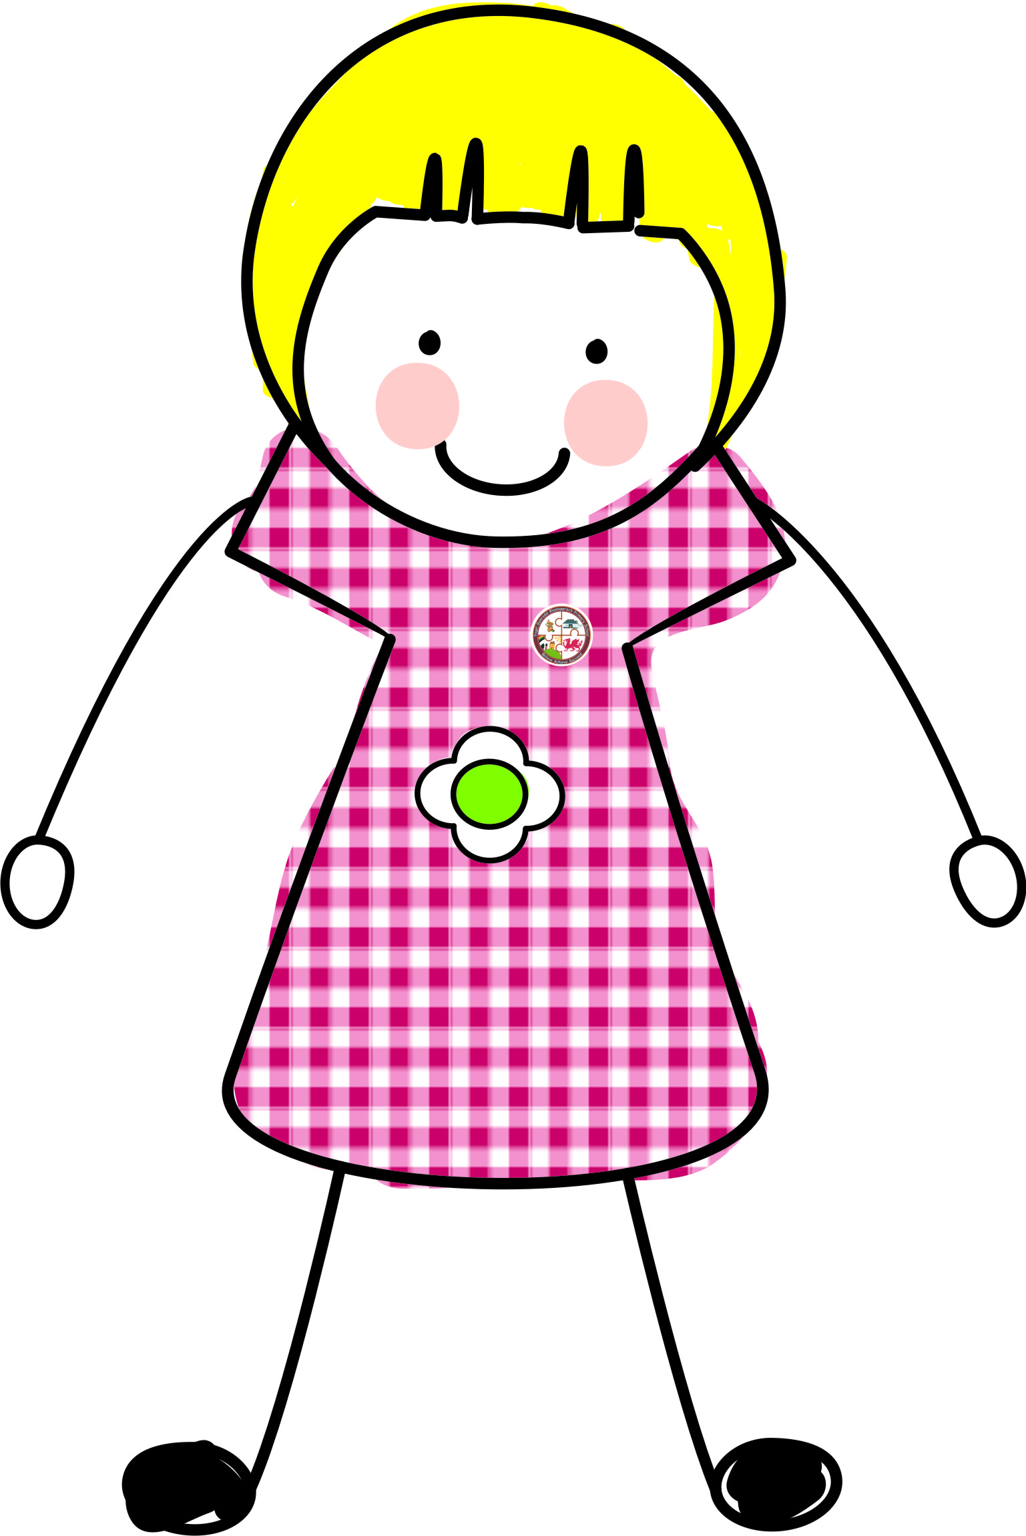

School Context
Number on roll (July 2025) | Number of Year 6 leavers in 2025
153
Almost all of our year 6 pupils (24-25) transitioned to Llangatwg Community Comprehensive school with 3 pupils transitioning to Maesydderwen Comprehensive School and 1 pupil transitioned to Morriston Comprehensive School.
8 pupils registered to start in Autumn 2025. Nursery pupils will start as soon as possible after their third birthday.
Class Structure for the academic year 2024/25
Class | Pupil Numbers
Eirlys (N/R) | 36 Nursery 12 Reception
Blodyn Menyn (R/1/2) | 28
Briallen (3/4) | 29
Llygad y Dydd (4/5) | 29
Glas y Gors (5/6) | 28

Slide 6

Governing Body
The Governing Body has a key role in supporting and challenging the school on its standards and provision. Members have opportunities to visit the school throughout the year, to visit classes and to speak with staff and pupils.
You may contact the GB by addressing any correspondence to the Chair c/o Blaengwrach Primary.
GOVERNOR STATUS | NAME | DATE ELECTED | OFFICE ENDS
LA | Mrs Sharon Davies Vice Chairperson | 01/04/23 | 31/03/27
 | Vacancy
 | Cllr Hayley Davies | 27/09/22 | 26/09/26
COMMUNITY (CO-OPTED) (Minor Authority) | Mr Ward Jones | 05/01/24 | 04/01/28
 | Mr Richard B Owen Chairperson | 08/11/23 | 07/11/27
 | Carolyn Edwards | 30/06/23 | 29/06/27
 | Mr Jamie Ellson | 03/07/24 | 02/07/28
PARENT | Miss Ffion Edwards | 03/10/25 | 02/10/29
 | Mrs Grace Wild | 03/02/23 | 02/02/27
 | Miss Niamh Chammings | 15/05/24 | 14/05/28
 | Vacancy
HEAD TEACHER (Voting) | Mrs Louise Williams | 01/09/2023 | ---
NON-TEACHING STAFF | Mrs Ann Alexis | 01/10/25 | 30/09/29
TEACHING STAFF | Mrs Lian Lewis | 24/09/24 | 23/09/28
CLERK TO GOVERNING BODY:
Liam Price
Schools and Family Support Team
Neath Port Talbot Civic Centre
Port Talbot
SA13 1PJ
01639 763518

Slide 7
Staffing Structure for July 2025
Class | Staff
Eirlys (N/R) | Miss M. Finnemore Miss H. Griffiths Mrs J. Chammings Mrs L. James
Blodyn Menyn (1/2) | Miss R. Chugg Miss C. Sims (Miss O. Lay) Mrs S. Williams
Briallen (3/4) | Mrs L. Lewis Mrs D. Rychly
Llygad y Dydd (4/5) | Miss F. Edwards Mrs D. Rychly
Glas y Gors (5/6) | Miss E. Gully Mrs D. Rychly

Slide 8


Our School Day
Doors open | Session 1 | Break time | Session 2 | Lunchtime | Session 3 | Break time | Session 4
8.40am | 8.50am – 10.30am | 10.30am – 10.45am | 10.45am – 11.50am | 11.50am – 12.50pm | 12.50pm – 2.20pm | 2.20pm – 2.30pm | 2.30pm – 3.20pm
Nursery Session times
Morning session 8.50am - 11.20am Afternoon session 12.50 p.m.-3.20 p.m.
Site Security
External gates are locked between 8:50 and 3:15 p.m. All pupils and visitors entering the school during this time must do so through the main entrance and telephone to gain access. On entry to school all visitors are asked to sign in and wear visitor badges so they can be easily identified.

Slide 9
Breakfast Club and Extra-curricular clubs
There is a breakfast club at the school that runs from 8.10 until 8:40 every morning. The club is free, and the pupils can choose from toast, cereals, and juice/milk. For more information, please contact the school.
The school also has lunchtime and after school extra-curricular clubs that run from Monday until Thursday until 4.15 p.m. During the academic year 2024/25 pupils attended
Netball club
Art and craft club
Choir
Rugby club
Football club
Lego club
History club
Eco Club

Slide 10
Organisation
Our class structure is governed by our variable year group numbers. Where classes are involved in a mixed-age arrangement, the Governors agree that classes are organised according to a number of factors, including date of birth, balance of gender, dynamics, ability and friendship groups.
The needs of each child are catered for through the hard work and commitment of our dedicated staff. Detailed concept planning, a wide range of assessments and monitoring of progress with a thorough knowledge of where each child is on their learning journey and their next steps ensures that a purposeful, authentic curriculum is taught to cater for the needs and interest of each child.
Regardless of whether children are placed in a ‘single year group’ or a ‘mixed year group’, each specific cohort of children will display a range of abilities and qualities which our staff are highly trained to cater for. Each year group has access to ‘age’ and ‘stage’ appropriate experiences. At our school, there will be times when each child will work in a variety of different learning areas both inside and outside the classroom.
We are supported by peripatetic teachers for Music, and pupils are given the opportunity to learn to play a musical instrument. Currently our pupils are learning to play clarinet, flute and saxophone through individual and ensemble lessons with our Music teacher. NPT Cerdd provide first taster experience sessions to our Year 4 pupils including Brass and Strings, we are looking forward to our Year 4 pupils experiencing the NPT Cerdd Woodwind taster session during the academic year 2025/26.
We take the national priorities of high standards and aspirations for all very seriously. Regardless of which class a child is placed in, our highly trained staff cater for specific ‘groups of learners’ to ensure that each child is sufficiently challenged, making good progress in relation to their starting point and reducing barriers to learning.
Various intervention programmes including Language Link, Speech Link, Wellcomm etc. are taught to support various identified groups of learners throughout the week. Children are also taught in groups according to their stage and not their age throughout the week. This ensures children are receiving tailor made opportunities to reach their full potential.
Ensuring every pupil reaches their full potential remains a priority for the school and pupil progress is tracked closely to ensure the curriculum meets the needs of every child and any intervention that is required is identified early on.

Slide 11
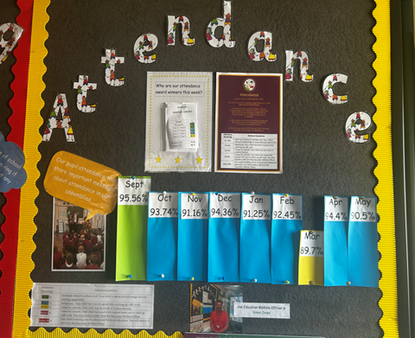
Attendance and Punctuality
Attendance and punctuality is rigorously monitored, with parents/carers being reminded in newsletters about the importance of contacting school on the first day of their child’s absence. We operate a First Day Response system and follow the Local Authority Attendance Policy. If we have not received a message from home, a text message is sent to which parents are requested to respond. Letters are sent to parents detailing any concerns and consequent procedures.
Attendance posters are displayed around the school reminding parents and carers of the importance of regular attendance.
Personalised colour coded individual pupil attendance percentages are sent to parents termly with a reminder of how important regular attendance and punctuality is.
A breakdown of the consequences of poor attendance is also included. This is helpful to keep parents and carers fully informed. We offer support regarding attendance to any family should they require it.
Our Education Welfare Officer visits the Head Teacher fortnightly and will visit families who require support and encouragement regarding attendance and punctuality (Article 28).

Slide 12

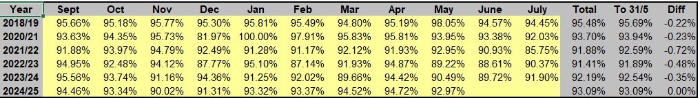

Attendance
Whole school attendance for 2024/25 was 92. 95% improving by 0.76% from the academic year 2023/24.
There were no exclusions during academic year 2024/25.
The numbers of families taking holidays during term-time continues to impact attendance during the Summer term. A first day response text and phone calls, traffic light letters, issuing of attendance letters 1 & 2, fortnightly meetings with EWO, parent meetings regarding attendance, EWS referrals and awards assemblies ensures attendance remains a high priority. A recent meeting with the EWO identified improvement in attendance for families with EWS involvement. School continues to interrogate the deviation between the highest attended session and lowest attended session throughout the week for each year group/class and the reasons given for absence.
Below 80% | 80-84.99% | 85-89.99% | 90-94.99% | 95% +
13 pupils including 7 Nursery pupils. | 7 pupils including 4 Nursery pupils | 18 pupils including 2 Nursery pupils | 48 pupils Including 7 Nursery pupils | 68 pupils 7 pupils currently have 100% attendance.
16.23% of statutory school age pupils across the school their attendance fell below 90%,
however, this is an improvement of 8.45%

Slide 13

Estyn interim visit
Following an interim Estyn visit in June 2025, findings from the visit reported that:
Leaders have an honest and accurate understanding of the progress the school has made since the core inspection, and of the next steps in the school’s development.
There is an increasingly reflective culture in the school. Leaders have established an inclusive approach to self-evaluation that involves all staff. Staff understand the important role they play in evaluating the school’s effectiveness. They appreciate the feedback, support and guidance they receive and are responsive to it.
Leaders have a clear vision for the approach to, and quality of, teaching in the school. They use a good range of self-evaluation activities effectively, helping them to understand and evaluate teaching and its impact on pupils’ learning. They use the information they gather appropriately to inform the next steps in the school’s development, including ongoing improvements to classroom practice.
Leaders and staff have recognised the need to ensure that feedback to pupils is more meaningful and supports progress in learning. The school has been suitably proactive and collaborative in its approach to achieving this.
All staff have engaged with relevant professional learning, and together, have revised the school’s policy and approach to providing effective feedback. This work is beginning to be evident in classroom practice, helping pupils to start to have a better understanding of how to move their learning forward.
Generally, teachers provide valuable and timely feedback to pupils. They have developed a helpful ‘conference’ approach to providing beneficial feedback during lessons. Through these conferences, staff or other pupils support pupils to make improvements to their work and deepen their understanding. This initiative is helping pupils to develop an appropriate understanding of the purpose and benefit of feedback and how to successfully act upon it.
Staff are beginning to use effective questioning techniques that, overall, help pupils to confirm and clarify their understanding. Where this practice is most effective, it encourages pupils to reflect on their learning and enables them to understand and address their next steps. This is helping pupils across the school to begin to develop as independent learners. This will be a focus for improvement during the academic year 2025/26.

Slide 14
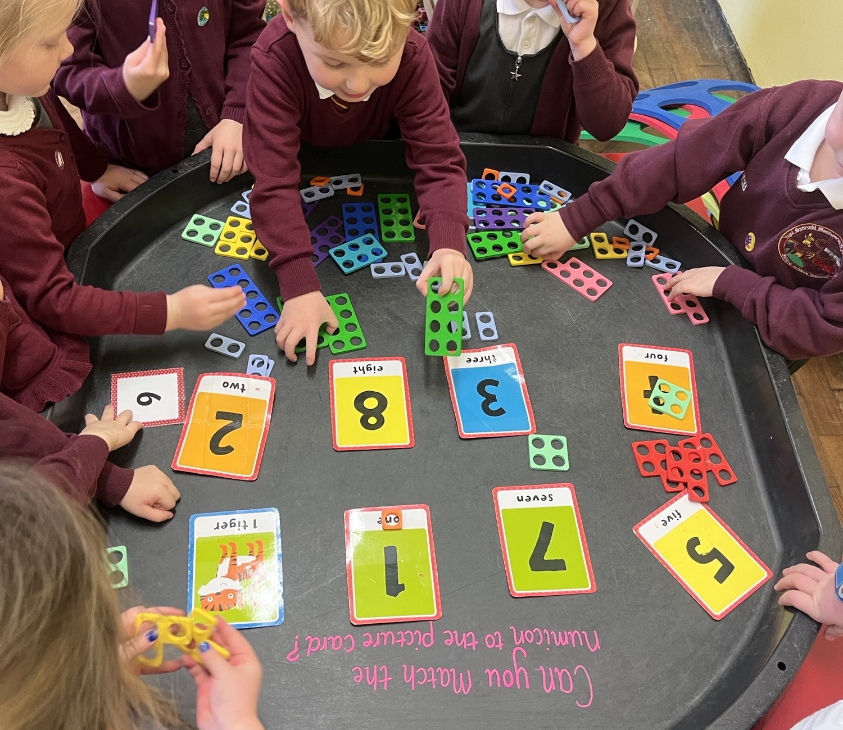
Our Curriculum
Everything we do and everything a child experiences at Blaengwrach Primary in pursuit of the four purposes is called our curriculum. Our school community have worked collaboratively to develop a shared vision for the curriculum and are developing a shared understanding of progression at Blaengwrach Primary School.
Our curriculum meets the requirements of Curriculum for Wales focusing on ensuring that our pupils embody the four purposes as Ambitious Capable Learners; Enterprising Confident Contributors; Ethical and Informed Citizens and healthy Confident Individuals. Our curriculum is progressive and ensures that pupils develop control and independence in the development of their literacy, numeracy, digital and integral skills in addition to ensuring pupils engage with increasingly complex and sophisticated content to progress their knowledge and understanding.
Learners develop their understanding of the What Matters statements. By exploring and revisiting the statements of What Matters our learners deepen their knowledge and understanding during their time at Blaengwrach and as part of their learning continuum to progress to a more sophisticated understanding of the key knowledge, ideas and principles in each Area of Learning and Experience (AoLE).
Concepts, topics, themes change from term to term, but the curriculum consists of six AoLEs and experiences as well as cross curricular themes of literacy, numeracy and digital competency. Our curriculum is designed to create a sense of belonging in our pupils in a physical, geographical, historical, cultural, social and cultural sense as a place that has shaped and continues to shape the community. We aim to support our children to make sense of their own identities and those of others in our community, in Wales and across the world, and to grow the self-belief to know that they can affect change, not just at home, in school, or in their community, but in Wales and on the world stage.
Our concepts and themes will change over time to reflect the society in which we live. The experiences our children will have been a part of at Blaengwrach aims to fire their imagination and shape their dreams. Through our curriculum our children will have goals to aim for, interests that sustain them and a passion for success with the very best chance of a future filled with happiness, choice and opportunity.

Slide 15
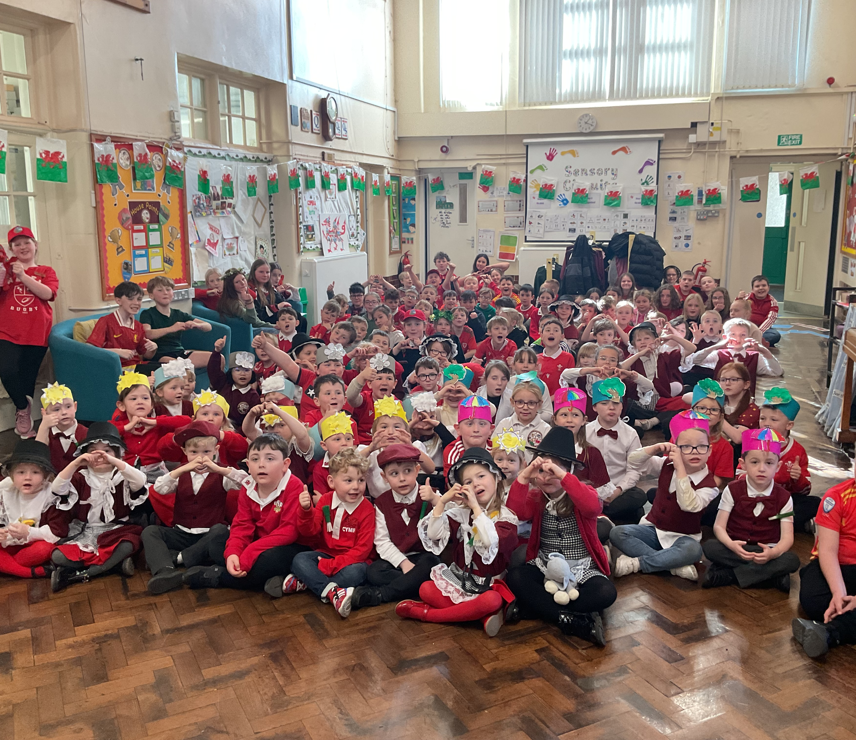
The Welsh Language
Although our pupils are taught through the medium of English, our pupils are encouraged to use Welsh throughout the day and when greeting others. Pupils are also encouraged to use Welsh to communicate outside of formal instruction such as games during playtime and instructions throughout the day.
Welsh is spoken and practised in each class throughout the school, and this is reinforced by our very enthusiastic Criw Cymraeg at breaktimes and during assemblies. The school actively promotes the development of the Welsh language and is committed to following the Siarter Iaith. We have been awarded the Bronze Siarter Iaith award and are working towards our Silver award.
The Welsh advisory team visit the school regularly to support and work alongside our teachers and children. We are members of the Urdd and as a result are able to enter the Eisteddfod competitions throughout the year and receive language support from the Urdd leaders. Our older pupils competed in the Urdd Eisteddfod during the academic year 2024/25 in the Art and Craft: Textiles competition, and two pupils experienced success being awarded 2nd and 3rd place in the local area rounds of the competition.
St. David’s day is an important part of our heritage and is celebrated through our curriculum; pupils have the opportunity where appropriate to apply their knowledge and understanding of the cultural, economic, environmental, historical and linguistic characteristics of Wales (Article 30).
During the academic year 2024/25 during Welsh week our children enjoyed a whole school family Welsh cultural activities including Art, rugby skills, Twmpath, poetry, handwriting, art and reciting competition, a Welsh language Silent disco, and a Year 6 Welsh language quiz with Menter Iaith competing in the final round of the competition alongside LA local primary schools.

Slide 16


Educational Trips and visits
We strive to provide a variety of meaningful experiences for our pupils, including educational visits, day trips and residential visits. Many trips and visits are undertaken during the year which complements our curriculum. Some experiences are residential in nature and are only available due the commitment of staff who give up considerable amounts of their own time. All year groups take part in a wide range of activities. Trips such as these provide great benefits for the children involved. We are indebted to the support from staff to make these visits possible. When possible, grants are applied for to enable all pupils to engage in school visits and we are looking forward to further planned visits and experiences during the academic year 2025/26.
During the academic year 2024-25 pupils have enjoyed visits to Abernant, Llangrannog, St Fagan’s, Theatr Na’Nog, Swimming at Glynneath Leisure Centre, Wiggly’s Farm, Zipworld, Urdd Eisteddford recording and Jambori, Techniquest Cardiff, Aberavon Beach, Crucial Crew, Margam Park, Gwyn Hall, Swansea Bay University for the Holocaust Memorial Concert, John Harries Rugby Tournament and regular visits to the local community.
There are many visitors to the school throughout the year, all of whom greatly enrich the pupils learning. The Governors are grateful to all of them for giving their time and expertise.
We encourage visitors to school to enhance the learning and experiences of our pupils. Pupils have enjoyed working with PC Kent, Steps of Faith, School Nurse, Fire Service, Missionaries from Brazil and American students, Local Historian and have experienced Lifesaving Skills, Road Safety and Cyclecraft, NPT Mobile Library, water safety and Scholastic Book Fair.

Slide 17
Additional Learning Needs
When school or LA is ‘made aware’ that a child or young person may have additional learning needs [ALN], it MUST decide whether that child or young person has additional learning needs unless:
an individual development plan (IDP) is already in place for the child or young person a decision has already been made and the school is satisfied that the child’s needs have not changed since that decision and there is no new information.
The system puts the learner at the heart of everything that happens, and our school takes a person-centred approach to planning for, and supporting children and young people. The ALN Act 2018 states that that the views, wishes and feelings of children, their parents and young people must be considered at all stages of the IDP process. Parents can request that a school consider their child’s needs and request that a decision regarding ALN and IDP’s are made.
As a caring school we are committed to inclusion and equality, we recognise the uniqueness of each individual. Every effort is made to provide the necessary resources to help all pupils access the curriculum as fully as possible. The school co-operates with other professionals in seeking each child’s full entitlement e.g. physiotherapist, speech therapist, visual impairment personnel, hearing impairment personnel etc. (Article 23).
Provision for additional learning needs is strong and very well coordinated.
Leaders track pupils' progress closely to identify strengths and when specific support is needed. They liaise well with outside specialists, such as the education psychologist and speech therapist, wellbeing and behaviour team, who provide further expertise.
Staff make effective use of detailed individual learning passports to summarise for parents their children’s strengths, interests, where they need more help and how this can be achieved. In addition, it includes a chronology of events, an Individual Development Plan (IDP) as well as a one-page profile. Also included is a 4 plus 1 sheet which helps staff to reflect, plan and respond on their provision, evidence of parental support, good day/bad day reports, professional reports and relevant tracking sheets.
A range of well-timed interventions ensure that pupils make appropriate progress in their learning from their varied starting points. Pupils who require additional support are identified at an early stage and have their needs met.
IDPs contain detailed, meaningful targets. Pupils and parents make an effective contribution to these processes, and this ensures that they understand the outcomes fully. When required, the school involves specialist services effectively. Intervention strategies have a positive effect. The school has effective arrangements to support pupils’ wellbeing. Staff have created a caring community that nurtures pupils’ personal and social skills effectively. Teachers and support staff know their pupils well and respond sensitively to the needs and interests of individuals.

Slide 18

Family Engagement
The Family Engagement Officer is attached to the school for one day per week as part of the Welsh Government LA Community Focused Schools project. The FEO organises and leads a Play and Stay group incorporating messy play on a weekly basis. Through this the FEO has built relationships with families, becoming a key link between home and school. The FEO has supported families in a variety of ways, signposting families to external agencies, e.g. food banks, Mr X appeal, supporting Year 6 pupils and families with transition to comprehensive school, supporting with the completion of school essential applications and free school meal applications and providing pre-loved uniform.
Further engagement of families during the academic year 2024/25 included attending school coffee mornings, planning parental engagement Story Sack sessions for Reception pupils and parents, organizing the attendance of the mobile library to school and planned class open events.
There is excellent attendance at our Parent/carer consultations throughout the academic year. This reflects the commitment of our parents and carers and their wish to play a full role in the education of their children, diolch yn fawr iawn.
Further work is planned for the academic year 2025/26 including pupil-led coffee and chat sessions, continuing our class open events, talking teens sessions for parents, Play and Stay for 0-4 year olds, continuing our Story Sack sessions, after school parent and child crafting club, and parental engagement sessions to support pupil’s emotional wellbeing with CAHMs.

Slide 19

Supporting our community and charities
At Blaengwrach Primary supporting our school community is a priority. Throughout the year, we assist families by providing access to food parcels, pre-loved school uniform and Christmas jumper swap, toy parcels and food hampers as part of our annual Christmas appeal.
We are pleased to be able to host our annual Christmas concerts for families and our local community and other community focussed events at the community hall and would like to thank local businesses, members of the community, and friends of the school for their very generous donations to support our pupils. We would like to express our sincere thanks to the Community Council for their continued support by allowing school to hire the Community Hall, a fantastic community facility, to support our pupils and families.
A huge thank you to Bramwood Timber for their very generous donation of an outdoor shelter during the academic year 2024/25 to support outdoor learning at Blaengwrach whatever the weather, diolch yn fawr iawn. Also, thank you to Asda and KFC, Cwmgwrach, for supporting us throughout the year with their kind donations for family and community engagement.
We are very pleased to be part of the Wales Credit Union programme, practice commended by Estyn during our Estyn Inspection in May 2023. Year 5 and Year 6 pupils run a Credit Union savings club for all full-time pupils. This is very popular, and many pupils are now long-standing savers; promoting financial management is a very important life skill.
Cynefin has formed a large part of the school curriculum over the past year. Pupils have enjoyed visiting local places and going on local walks throughout the community.
The school has strong links with our Cluster Family of Schools including primary and comprehensive schools. Staff meet with colleagues from our cluster of schools for training opportunities, shared INSET training and to seek and share good practice. As Family of Schools we work together to plan engaging transition activities for our pupils and we are looking forward to further collaboration during the academic year 2025/26.
We are very proud of the charity fundraising throughout the academic year and during the academic year we raised valuable funds for a variety of charities including Macmillan Cancer, Children in Need, Comic Relief, Dogs Trust, Jeans4Genes, Foodbank Wales etc. and donating clothes to Rags2Riches. A huge thank you for all the very kind and generous donations made by our families and school community to charities throughout the year.

Slide 20
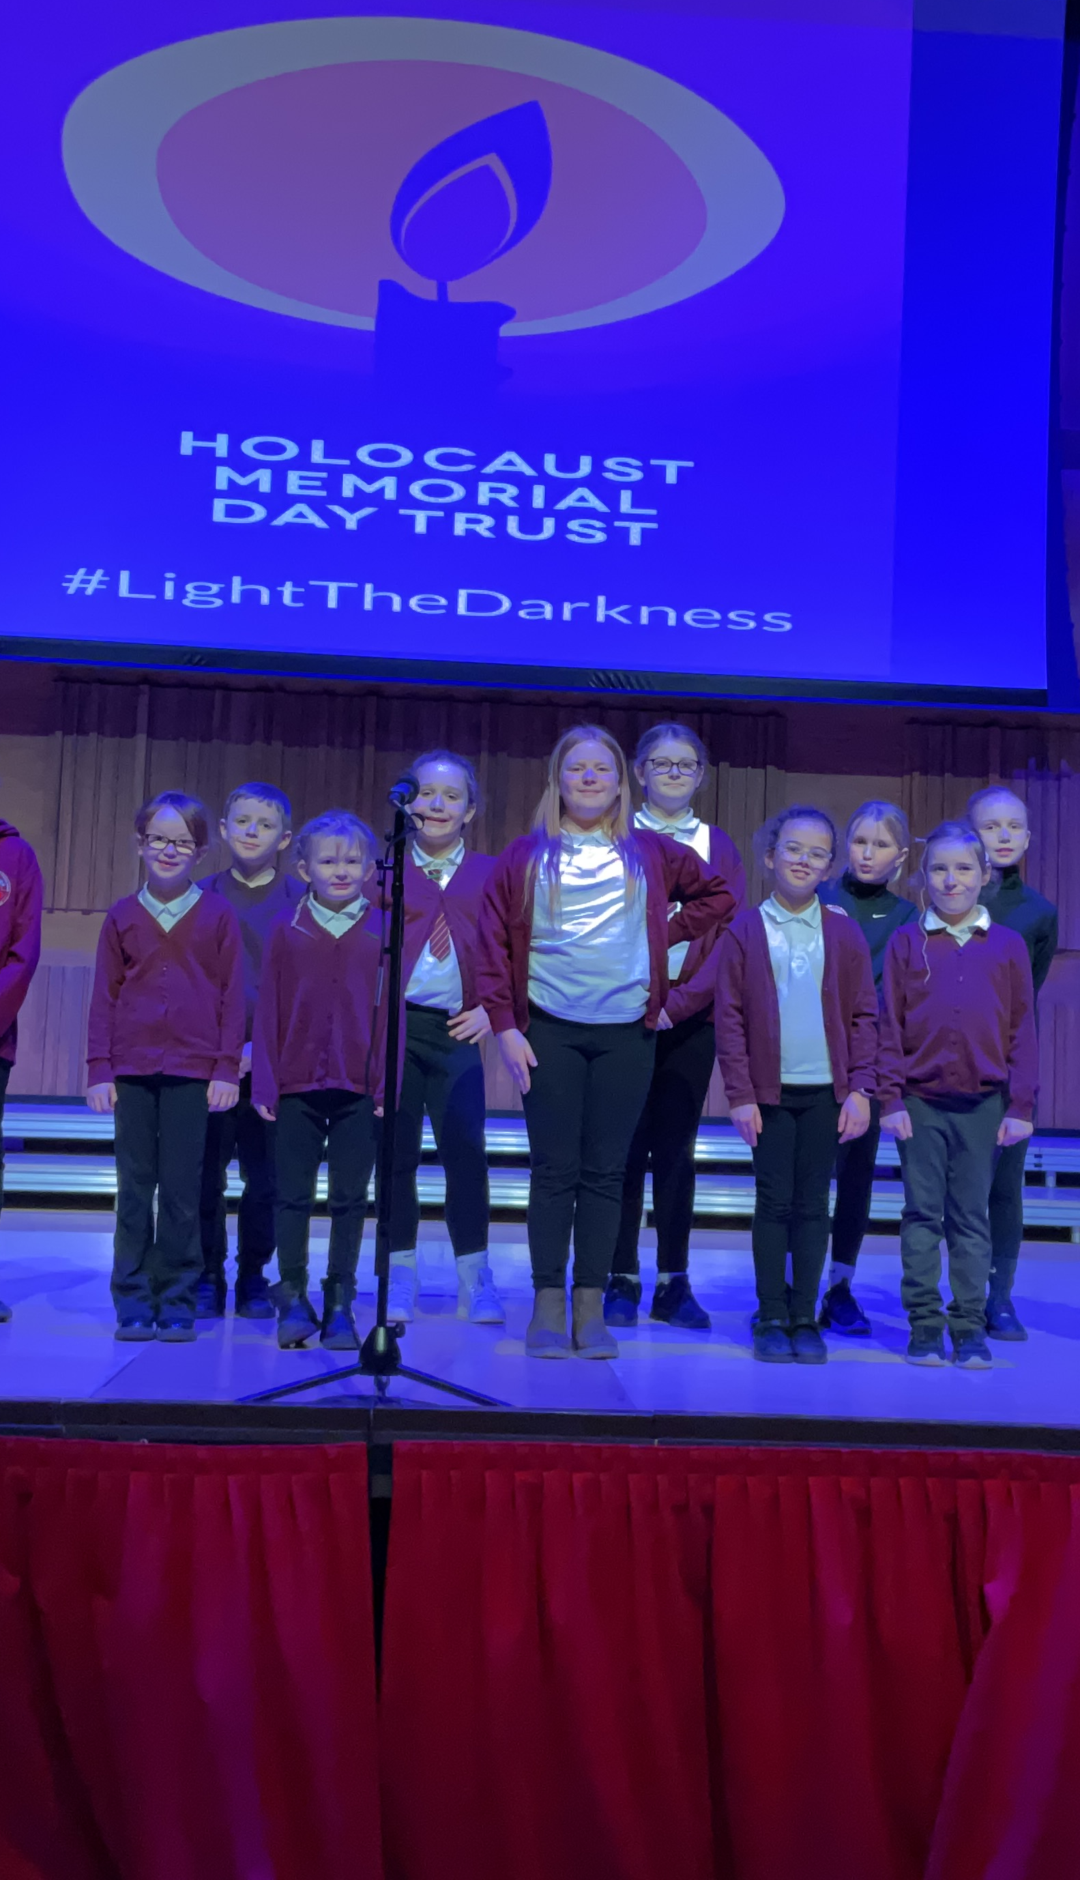
Musical talent
Our peripatetic music teacher delivers music tuition each week. The children have the opportunity to play flute, clarinet or saxophone.
During Autumn term 2024 our Year 4/5 pupils received ‘First Taster’ Drama lessons with NPT Cerdd and Year 5/6 Ukulele workshop. Our year 4 pupils also received taster string instrument lessons during the Spring term. We would like to sincerely thank NPT Cerdd for providing this fantastic opportunity for our pupils and look forward to Year 4 woodwind taster sessions during the academic year 2025/26.
There is also a well-attended choir club at lunchtime which enables pupils to perform at various events in school and in the community including an emotional performance at the Holocaust Memorial Concert.

Slide 21

Sporting achievements
Sport in our school continues to thrive as we continue to provide our children with a full and varied programme of sporting activities.
The school has a very successful rugby, football and netball team. Pupils have taken part in tournaments and have been very successful. We continue to strive for an inclusive sports curriculum, whereby all pupils enjoy a full range of sporting activities (Article 31).
During the academic year 2024/25, a number of pupils attended trials and we are extremely proud of their resilience and success with one pupil being selected for the Neath Schools Rugby team, da iawn pawb!
Staff and Governors would like to congratulate the many pupils who have taken part in all the sporting and non-sporting activities throughout the year and all the dedicated staff, parents and friends who regularly give their free time to help the pupils and school achieve the many sporting successes.

Slide 22
Healthy Eating
Mrs Canham is our Healthy School Co-ordinator, and we have been successfully awarded the prestigious Healthy Schools National Award. Throughout the year, we have taken several steps to support healthy eating across the school:
Healthy School Meals: Our school meals continue to meet the Welsh Government’s nutritional standards. We offer a balanced menu that includes fresh fruit and vegetables daily, and we cater for a range of dietary needs. Lunchboxes are encouraged to be healthy; fizzy, sugary drinks are avoided by all pupils.
Healthy Snacks: Pupils are encouraged to bring healthy snacks such as fruit or vegetables for break times. In addition, a Fruit Tuck Shop is run every break time by the Year 6 prefects to encourage healthy eating and develop numeracy skills. We also discourage sugary treats and fizzy drinks.
Drinking water: Children have access to fresh drinking water throughout the day, and we encourage them to bring reusable water bottles to stay hydrated and to be able to concentrate more readily.
Links to the curriculum: Healthy eating is embedded in our curriculum through science, health and wellbeing lessons, and themed activities. Pupils learn about food groups, nutrition, and the importance of a balanced diet.
Celebrating Success: We celebrate pupils who make healthy choices and take part in related activities, reinforcing positive behaviour in a fun and encouraging way.
We are very pleased to be actively involved in promoting the Anti-Bullying Alliance message during Anti-Bullying Week and throughout the school year. We strongly encourage pupils in our school to choose respect, support each other, and consider each other’s feelings and wellbeing.
Staff have attended Zones of Regulation and we have 2 fully trained Emotional Literacy Support Assistants to support pupil’s social and emotional development and wellbeing. Sessions are regularly planned to support pupils individually and within small groups/class sessions.

Slide 23
Friends of Blaengwrach
Friends of Blaengwrach very kindly give up their own time to plan, organise and fundraise to support the children of Blaengwrach. A huge thank you for your incredible hard work and support throughout the academic year 2024/25.
During the year, Friends of Blaengwrach have planned and organised an exciting Easter Scavenger Hunt during Easter weekend with a special Easter bunny visit on route!
Friends of Blaengwrach have made very kind donations to school including a TV screen for the main school hall for whole school use – assemblies, visitor presentations, etc. They have also supported school with the cost of the installation of interactive screens in classes across the school and the annual introductory package of our Jolly Phonics interactive package.
A huge thank you to the Friends of Blaengwrach for their invaluable support for the children of Blaengwrach and thank you to our families and school community for supporting their planned events.

Slide 24
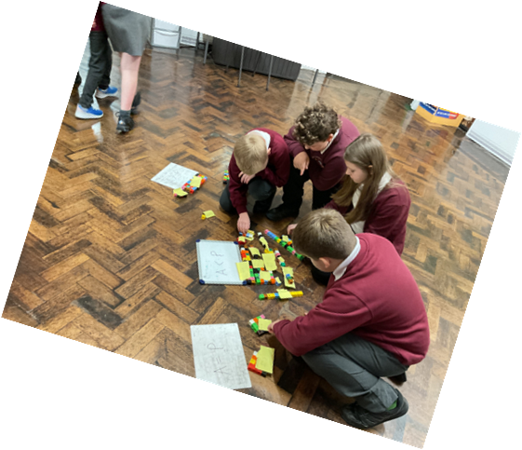
School Improvement Plan & Self-Evaluation
The school has a very rigorous monitoring and self-evaluation programme that is linked to our School Improvement Plan priorities. SIP priorities are shared with staff, pupils, governors and parents and we work together to achieve our goals. Our School Improvement Plan (2024/25) and the Self-Evaluation Review can be found on our school website.
Our priorities in the School’s 2025-26 School Improvement Plan include:
Priority 1- To develop pupils’ integral skills to further enhance independence.
Priority 2- To improve teaching, assessment and feedback to ensure pupils make effective progress in line with the expectations of Curriculum for Wales and to inform next steps in learning.
Priority 3 - To improve pupils’ literacy skills, in particular writing.
Priority 4 – To improve pupil attendance of groups of learners.

Slide 25
Financial position for April 2024 – March 2025
The budget for 2025/26 has been discussed and ratified by the full Governing Body
BUDGET | £ | EXPENDITURE | Actual (£)
Formula Allocation | £590,601
TOTAL | £590,601 | GROSS EXPENDITURE | £ 784,870.87
 |  | Less: Income | £ 164,843.38
 |  | NET EXPENDITURE | £ 620,027.49
Projected Under Spend |  |  | -£ 26,782.49
Principal Investment 1/4/24 |  |  | £ 17,569.00
Total Investment 31/3/25 |  |  | -£ 9,213.49

Slide 26

Key Dates for the Academic Year 2025/26
Autumn term 2025
Monday, 1 September - Friday, 24 October
Half-term holiday: Monday, 27 - Friday, 31 October
Monday, 3 November - Friday, 19 December
Christmas holiday: Monday, 22 December - Friday, 2 January
Spring term 2026
Monday, 5 January - Friday, 13 February
Half-term holiday: Monday, 16 - Friday, 20 February
Monday, 23 February - Friday, 27 March
Easter holiday: Monday, 30 March - Friday, 10 April
Summer term 2026
Monday, 13 April - Friday, 22 May
Half-term holiday: Monday, 25 - Friday, 29 May
Monday, 1 June - Monday, 20 July
Summer holiday: Tuesday, 21 July - Monday, 31 August
Schools will be closed to pupils for INSET/Staff preparation on six days between Monday, 1 September 2025 and Monday, 20 July 2026.
Details of INSET days will be sent via text, newsletters or through the school website.

Slide 27
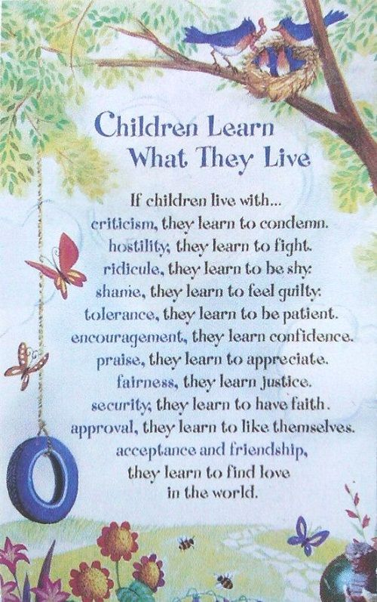
Acknowledgements
The Governing Body wishes to thank pupils, staff and the community who all play a huge role in helping the school achieve its goals. Our school continues to grow from strength to strength and when we all work together and when each and every learner believes in themselves, they can achieve their goals and succeed in their chosen path.

